Slide 1
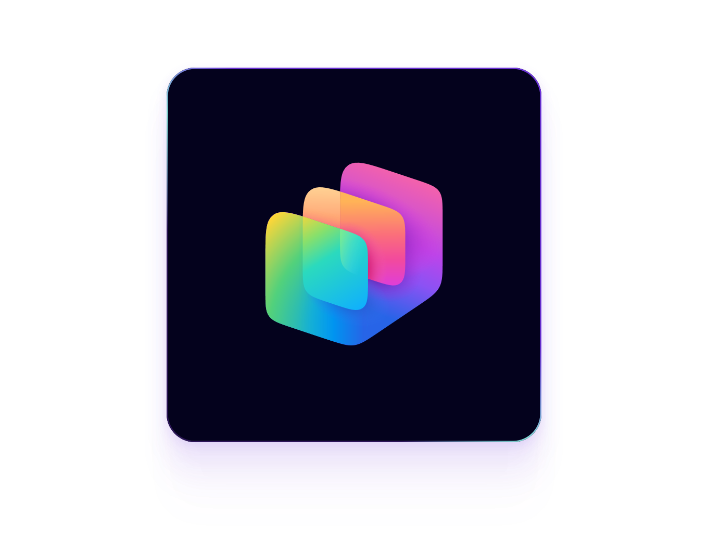
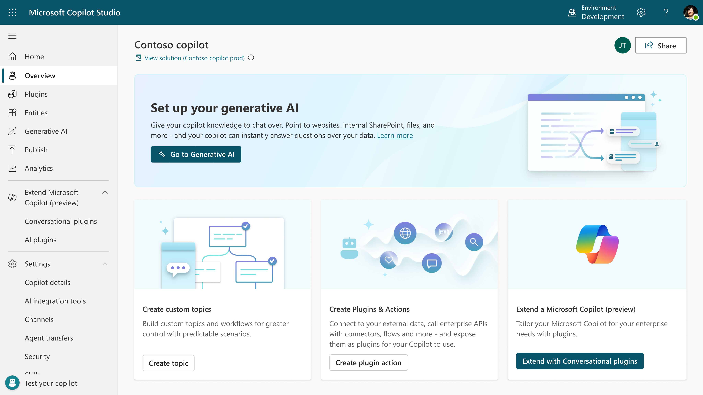
HR Agent Built with Copilot Studio
Business Need
Organizations often receive a high volume of repetitive HR questions related to benefits, PTO, onboarding, and internal policies. Employees struggle to find accurate information across scattered documents and systems, while HR teams spend significant time responding to inquiries that could be handled through self-service. A streamlined, intelligent support channel was needed to provide consistent answers and reduce manual workload.
Copilot Studio
What We Did
Created a custom HR Agent using Microsoft Copilot Studio tailored to common HR inquiry categories
Structured and grounded HR content to ensure accurate and consistent responses
Built conversational topics and guided flows to automate routine HR processes
Integrated the agent with Microsoft 365 tools and connected systems for document retrieval and task automation
Conducted iterative refinement cycles incorporating user feedback to improve accuracy and experience
Results
Reduced manual HR inquiry volume by enabling instant, self-service answers
Improved employee access to timely and accurate HR information
Increased consistency in how HR policies and processes are communicated
Freed HR staff to focus on higher-value initiatives instead of routine questions
Established a scalable foundation for expanding AI-driven support across other teams and departments

Slide 2
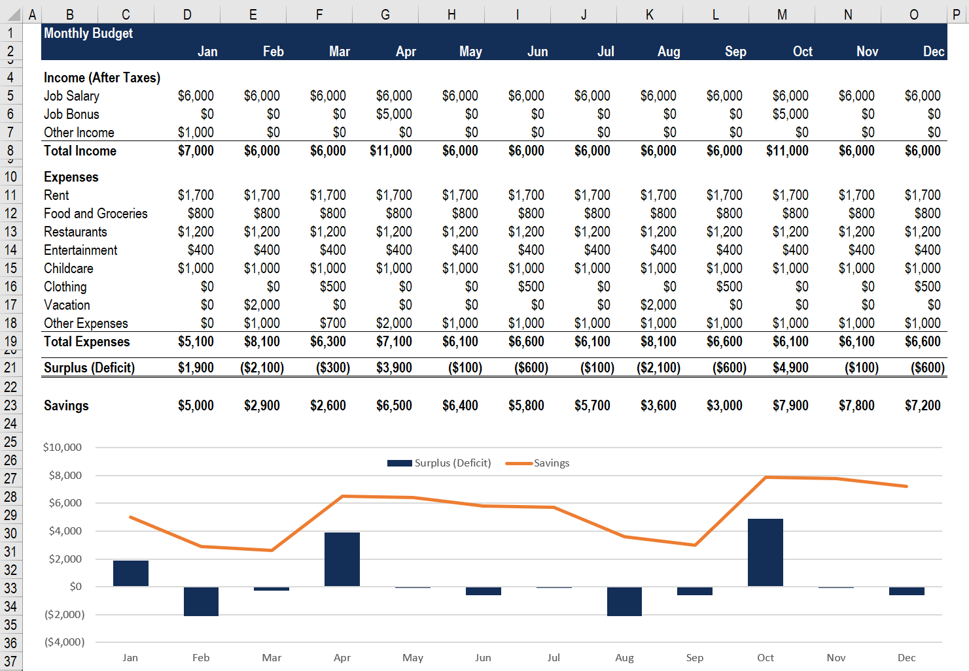
Customer Service Agent Built with Microsoft Copilot Studio
Business Need
Customer service teams often manage large volumes of repetitive inquiries that slow resolution times and create inconsistent service experiences. Knowledge articles, troubleshooting steps, and policies are spread across multiple systems, making it difficult for agents and customers to quickly find accurate information. Organizations needed a scalable way to improve responsiveness, reduce support backlog, and deliver a more consistent customer experience across channels.
What We Did
Built a Customer Service Agent using Microsoft Copilot Studio capable of understanding and responding to common support questions
Grounded the agent in validated knowledge articles, troubleshooting guides, and customer policies to ensure accurate and consistent answers
Created conversational flows for self-service steps such as order status checks, returns, troubleshooting, and account updates
Integrated the agent with CRM and ticketing systems to retrieve customer details, create cases, and escalate when needed
Refined the agent’s logic and responses through iterative testing with support teams and real customer inquiries
Copilot Studio
Results
Reduced inbound tickets through automated self-service for common issues
Increased first-contact resolution with better access to troubleshooting and policy info
Improved customer satisfaction via faster, consistent multi-channel responses
Enabled agents to focus on complex, high-value cases
Built a scalable foundation for expanded automated support across products and channels

Slide 3

Financial Analysis Agent Built with Microsoft Copilot Studio
Business Need
Customer service teams handle large volumes of repetitive inquiries, slowing response times and creating inconsistent experiences. Knowledge is often spread across multiple systems, making it hard for agents and customers to access accurate information quickly. A scalable, intelligent support channel was needed to improve responsiveness and reduce the manual workload.
What We Did
Built a Customer Service Agent in Microsoft Copilot Studio to answer common support questions
Grounded the agent in approved knowledge articles, troubleshooting steps, and customer policies
Designed conversational flows for tasks like order status, returns, troubleshooting, and account updates
Integrated with CRM and ticketing systems to retrieve information and create or escalate cases
Conducted iterative testing with support teams to refine accuracy and usability
Copilot Studio
Results
Lowered ticket volume by enabling automated self-service for common issues
Improved first-contact resolution through consistent, accurate guidance
Increased customer satisfaction with faster, clearer responses
Freed support teams to focus on complex, high-value cases
Created a foundation to expand automated support into additional products and channels

